Slide 1
Arousal
Recovery

Slide 2
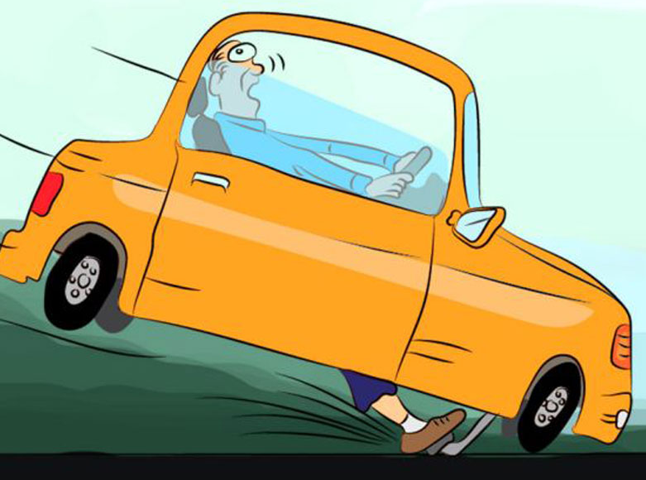
Vagal Brake
Less Brake
V
More Brake

Slide 3


Survival: Fight/Flight
Arousal
!
Recovery
Survival: Freeze

Slide 4
Arousal
Window of Tolerance
Recovery

Slide 5

Arousal
Window of Tolerance
Recovery

